Slide 1

Internet Banking System

Slide 2

Introduction
Project requirements
System modules
User interface specification
Use case and data flow diagram’s

Slide 3
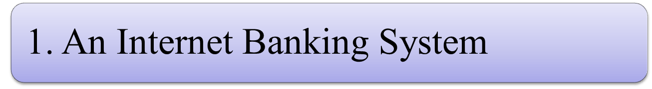
“Internet banking” refers to systems that enable bank customers to access
accounts and general information on bank products and services through
a personal computer (PC) or other intelligent device.
Our aims at creation of secure banking system.
this will be accessible to all users who have a valid user Id and password.
A cusomer can access his account from anywhere.

Slide 4
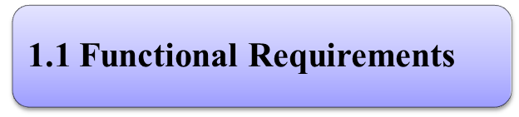
Customer can request details of the last ‘n’ number of transactions he has performed on any account.
Customer can make a funds transfer to another account in the same bank.
Customer can request for cheque book
Customer can view his monthly statement. She/he can also take print out of the same.
Customer can make EFT’s to accounts at their and other banks. The system is providing balance enquiry facility.

Slide 5
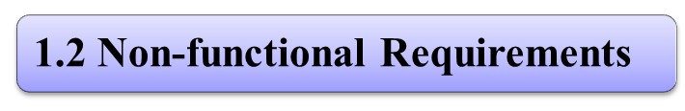
Secure access of require data.
24X7 availability
user friendly
Intelligent user interfaces

Slide 6
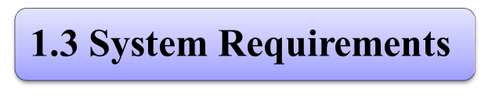
Software Requirements | Hardware Requirements
Operating System: Windows or linux or MAC | Processor: any
User Interface: HTML, APPLET | Hard Disk: 10 GB minimum
Programming Language: JAVA | RAM: 256MB or more
Database: ORACLE | Any Screen
Web Server Tomcat-Apache

Slide 7
Technologies to be used:
J2EE applications are made up of components. A J2EE component is a self-contained functional software unit that is assembled into a J2EE application with its related classes and files and that communicates with other components. The J2EE specification defines the following J2EE components:
Application clients and applets are components that run on the client.
A servlet is a Java programming language class that is used to extend the Capabilities of servers that host applications access via a request-response Programming model. Although servlet can respond to any type of request, they are commonly used to extend the applications hosted by web servers.
JAVASERVER Pages (JSP) technology allows you to easily create Web content that has both static and dynamic components. JSP technology Makes available all the dynamic capabilities of Java Servlet technology but provides a more natural approach to creating static content. The main Features of JSP technology are as follows:

Slide 8
2.0 System Modules:
System Modules | Description
(a) Login Module | A user can login with id & password
(b)Open Account | New user can add a account
(c)Balance Enquiry | User can check his balance
(d)Account History | A user can check his account history
(e)Admin Module | Admin can change in function or other action
(f)Loan Module | User can apply for a loan(car,education..)
(g)Money Transfer | User can transfer money

Slide 9
2.1 DATA FLOW DIAGRM OF SYSTEM MODULES
Balance Enquiry
Money Transfer
INTERNET
BANKING
Loan Module
LOGIN
MODULE
NEW CUSTOMER DATA
ACCOUNT
HISTROY
ACCOUNT
OPENING

Slide 10
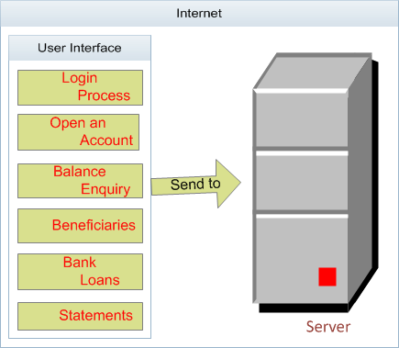

Event Diagram
The diagram below indicates the customer connects to the internet to perform all the transactions after he logged in successfully then the information will receive the server to maintain the requirements, and it will send a copy of the data to the database and vice versa.
Data base
Backend Process

Slide 11

1.0 Home Page

Slide 12
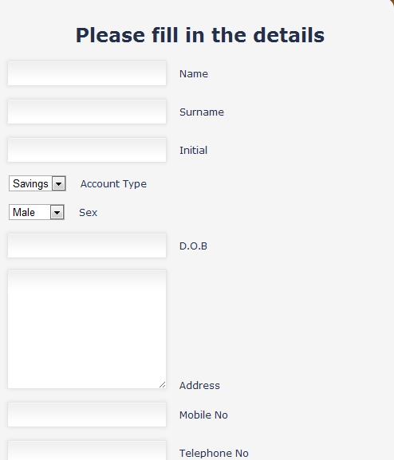
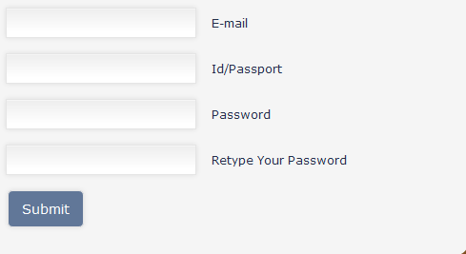
1.1 Registration form and opening a new account

Slide 13
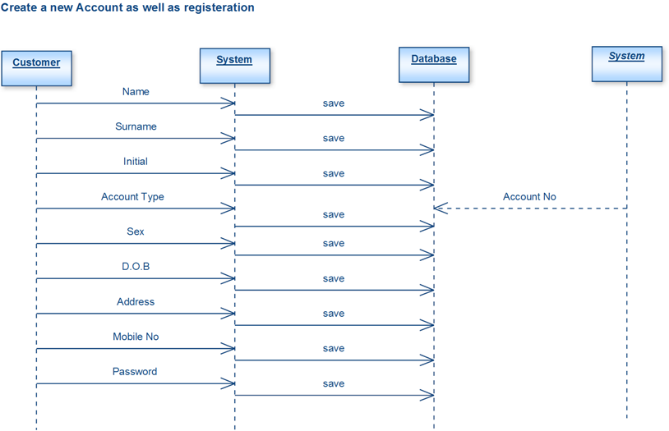
1.2 How the user interacts with the system

Slide 14
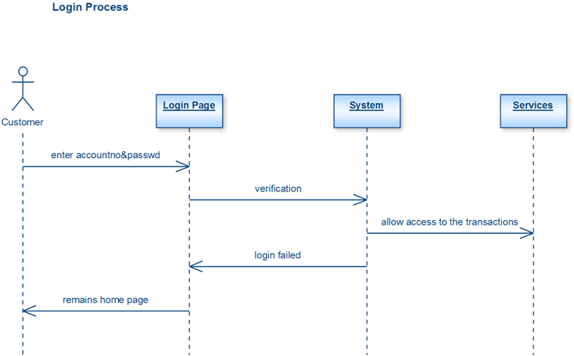
1.3 Login Process

Slide 15
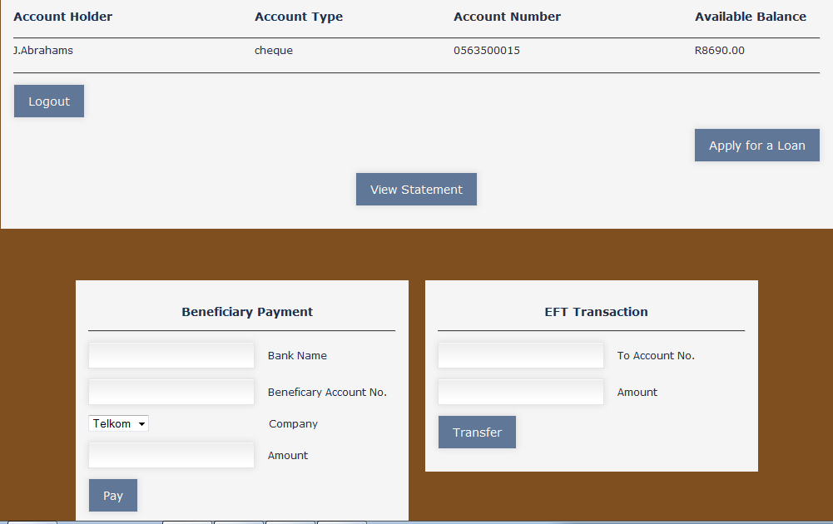
1.4 Transaction page
Transaction Page

Slide 16
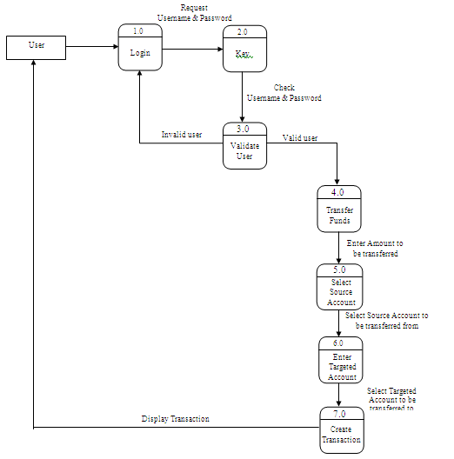
1.5 fund transfer

Slide 17
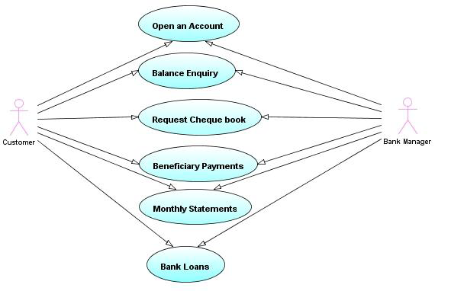
Use Case diagram of customer requirements

Slide 18
Over all working of Internet Banking
User
Registration Info
1.0
Registration Process
(a)
Reply
Request /respond
(b)
3.0
Account
Opening process
(c)
User Details
(d)
Reply
Online Banking System
Database
Valid user
4.0
Account Transaction
(e)
(f)
Access
(m)
2.0
Login System
(g)
Login_ Info
Access
5.0
Loan
(n)
Valid user
(h)
6.0
Customer
Feed Back
(i)
(j)
Access
Administrator
7.0
Create and
Update Process
(k)
Valid Administrator
(l)

Slide 19
conclusion
The application demonstrate the way to develop an online banking
system by using interactive web client by using JSP, Servlet
with more secure way to access.
This means the application server easily deployable and accessible.
<number>`

